Slide 1
Rheology Definition and Fundamental Concepts
NIMRA WAHEED
Department of Pharmaceutics

Slide 2
Lecture Content
Rheology
Fundamental Concepts of Rheology
Viscosity
Fluidity
Newtonians and Non-Newtonian Fluids

Slide 3
RHEOLOGY
The term rheology is derived from the Greek rheo (flow) and logos (science). Rheology is the science that studies the flow of liquids and deformation of solids.
The term rheology from the Greek “Rheo” (to flow) and “logos” (science), was suggested by Bingham and Crawford to describe the flow of liquids and the deformation of solids.

Slide 4
Fundamental Concepts
Rheology is involved in the mixing and flow of materials, their packaging into containers, and their removal prior to use, whether this is achieved by pouring from a bottle, extrusion from a tube, or passage through a syringe needle.
The rheology of a particular product, which can range in consistency from a fluid to a semisolid to a solid, can affect its patient acceptability, physical stability, and even biological availability. For example: viscosity has been shown to affect absorption rates of drug from the gastrointestinal tract.

Slide 5
Viscosity and Fluidity
Viscosity is an expression of the resistance of a fluid to flow; the higher the viscosity, the greater is the resistance.
For example, the viscosity of a toothpaste is significantly higher than a mouthwash. Viscosity is denoted by the symbol η.
Another term also commonly used in rheology is fluidity.
Fluidity is the ease with which a liquid or a fluid flows, and is defined as the reciprocal of viscosity. Fluidity is denoted by the symbol Φ and expressed by Eq: Φ = 1 /η

Slide 6
Newtonian Versus Non-Newtonian Fluid
Fluids that flow according to Newton’s law of flow are called Newtonian systems, whereas those that do not comply are called non-Newtonian systems.
A Newtonian fluid is one whose viscosity is not affected by shear rate: all else being equal, flow speeds or shear rates do not change the viscosity
Water for injection is a Newtonian fluid, but zinc oxide paste and ointment are examples of non-Newtonian fluids.

Slide 7
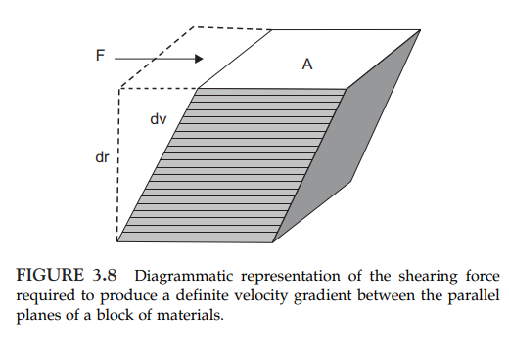

Newtonian Liquids
Consider a “block” of liquid consisting of parallel plates of molecules, similar to a deck of cards, as shown in Figure 19–1. If the bottom layer is fixed in place and the top plane of liquid is moved at a constant velocity, each lower layer will move with a velocity directly proportional to its distance
from the stationary bottom layer. The difference of velocity, dv, between two planes of liquid separated by an infinitesimal distance, dr, is the velocity gradient or rate of shear, dv/dr. The force per unit area, F/A, required to bring about flow is called the shearing stress and is given the symbol F. Newton was the first to study flow properties of liquids in a quantitative way. He recognized that the higher the viscosity of a liquid, the greater is the force per unit area (shearing stress) required to produce a certain rate of shear. Rate of shear is given the symbol G. Hence, rate of shear should be directly proportional to shearing stress, or
where η is the coefficient of viscosity, usually referred to simply as viscosity.

Slide 8

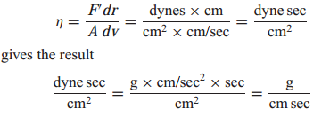
Newtonian Liquids Cont..
where F = F/A and G = dv/dr. A representative flow curve, or rheogram, obtained by plotting F versus G for a Newtonian system is shown in Figure 19–2a. As implied by equation (19–2), a straight line passing through the origin is obtained. The unit of viscosity is the poise, defined with reference to Figure 19–1 as the shearing force required to produce a velocity of 1 cm/sec between two parallel planes of liquid each 1 cm2 in area and separated by a distance of 1 cm. The cgs units for poise are dyne sec cm−2 (i.e., dyne sec/cm2) or g cm−1 sec−1 (i.e., g/cm sec). These units are readily obtained by a dimensional analysis of the viscosity coefficient. Rearranging equation (19–1) to
A more convenient unit for most work is the centipoise (cp, plural cps), 1 cp being equal to 0.01 poise

Slide 9
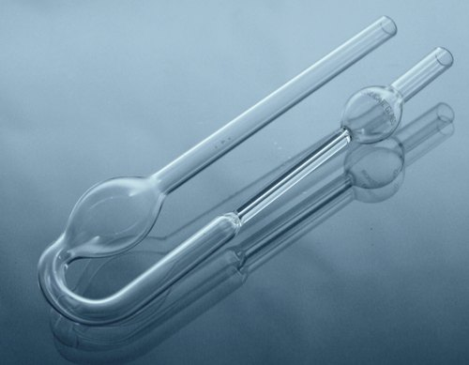
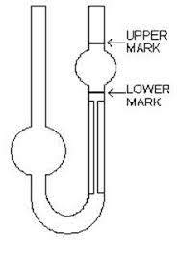
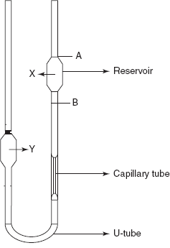
Measurement of Viscosity
An instrument designed to measure viscosity is called a viscometer. The viscometer commonly used is Ostwald Viscometer.
Ostwald viscometer (Capillary)
The Ostwald viscometer is used to determine the viscosity of Newtonian fluid.
The viscosity of Newtonian fluid is determined by measuring time required for the fluid to pass between two marks.

Slide 10
Lecture Content
Important Basic Concepts for Understanding Rheology
Fluidity
Kinematic Viscosity
Temperature Dependence and the Theory of Viscosity
Non-Newtonian Systems
Flow curves of Different Materials
Plastic Flow
Pseudo-plastic Flow
Dilatant Flow

Slide 11
Important Basic Concepts for Understanding Rheology
Newton’s law: According to NEWTONS LAW higher the viscosity of a liquid, the greater is the force per unit area (shearing stress F) required to produce a certain rate of shear( G). i.e. rate of shear α shearing stress
F= ῃ G
Viscous/ Plastic behavior: Deformation of the formulation stops once the applied force is removed. (property of ideal Newtonian liquids)
Rate of shear: Velocity gradient (dv/dr)= the difference in velocity (dv) between to planes of liquids (layers) separated by an infinitesimal distance (dr). The rate of change of velocity at which one layer of fluid flows over an adjacent parallel layer.
Shear stress: The force per unit area (F'/A) required to bring about the flow unit, Dynes/cm2

Slide 12

Fluidity
Fluidity, φ, a term sometimes used, is defined as the reciprocal of viscosity:

Slide 13

Kinematic Viscosity
Kinematic viscosity is the absolute viscosity divided by the density of the liquid at a specific temperature:
The units of kinematic viscosity are the stoke (s) and the centistoke(cs).

Slide 14
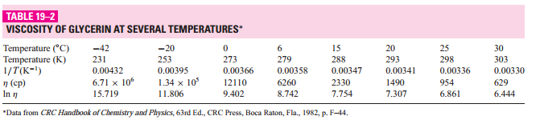
Temperature Dependence and the Theory of Viscosity
Whereas the viscosity of a gas increases with temperature, that of a liquid decreases as temperature is raised, and the fluidity of a liquid (the reciprocal of viscosity) increases with temperature.

Slide 15
Non-Newtonian Systems
The majority of fluid pharmaceutical products are not simple liquids and do not follow Newton's law of flow. These systems are referred to as non-Newtonian.
Non-Newtonian behavior is generally exhibited by liquid and solid heterogeneous dispersions such as colloidal solutions, emulsions, liquid suspensions, and ointments.
These systems change their flow behavior when exposed to different stress conditions.
When non-Newtonian materials are analyzed in a rotational viscometer and results are plotted, various consistency curves, representing three classes of flow, are recognized:
Plastic
Pseudo-plastic (shear thinning)
Dilatant (shear thickening)

Slide 16
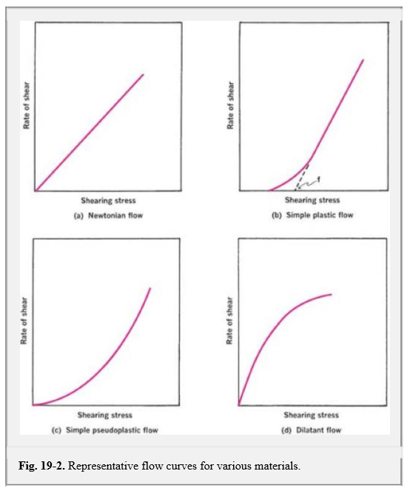
Flow curves of Different Materials

Slide 17
Plastic Flow
In which curve does not pass through the origin, the substance behaves initially as elastic body and it fails to flow when less amount of stress is applied.
As increase the stress, leads to non-linear increase in shear rate but after that curve is linear.
The linear portion extrapolated intersects the x axis at the point called as yield value So, plastic flow shows Newtonian flow above the yield value.
High shear stress: materials will flow as viscous fluids (bingham bodies)
Low shear stress: materials will flow as rigid bodies
Materials will not flow until shear stress has exceeded a certain yield value f, (minimum shear stress required to initiate flow)
Rheogram: line does not pass through origin (i.e. passes through shear stress axis in dynes cm-1

Slide 18
Plastic Flow (Cont..)
The curve represents plastic flow, such materials are called as Bingham bodies.
Bingham bodies does not flow until the shearing stress is corresponding to yield Value exceeded.
So, yield value is important property of certain dispersions.
The reciprocal of mobility is Plastic viscosity
EXAMPLES: ZnO in mineral oil, certain pastes , paints and ointments

Slide 19
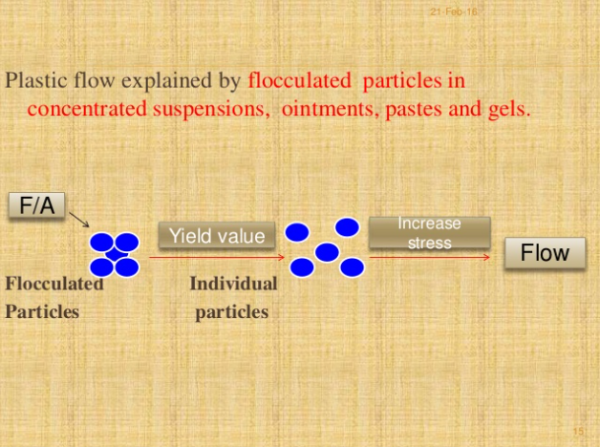
Plastic Flow (Cont..)

Slide 20
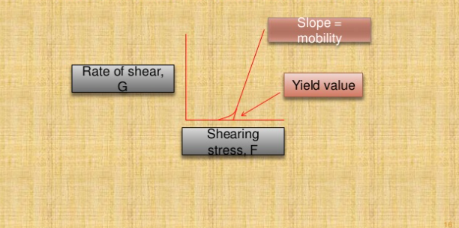
Curve of Plastic Flow
The curve of plastic flow is as follows:

Slide 21
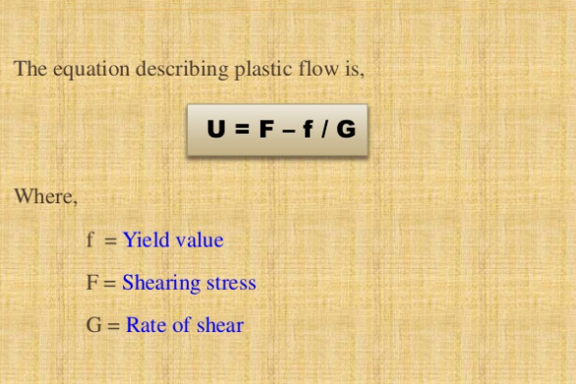
Equation of plastic flow

Slide 22
Pseudoplastic flow:
1. Material will flow as soon as shear stress is applied 2. Viscosity will decrease as the shear rate is increased 3. Viscosity cannot be expressed by single value 4. Reversible as soon as sheer force is removed fluid goes back to its original state

Slide 23
Many Pharmaceutical products liquid dispersion of natural and synthetic gums shows pseudo plastic flow.
eg.
1. Tragacanth in water
2. Sod. Alginate in water
3. Methyl cellulose in water
4. Sodium CMC in water

Slide 24
Pseudoplastic Flow (Cont..)
With increase in the shearing stress the disarranged molecules orient themselves in the direction of flow, thus reducing friction and allows a greater rate of shear at each shearing stress.
This type of flow behavior is also called as shear thinning system.

Slide 25
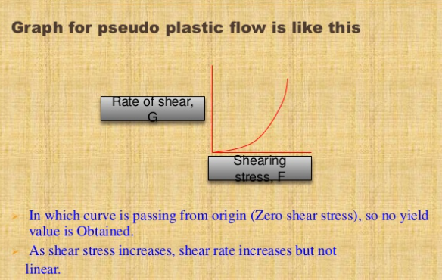
GRAPH (Pseudoplastic flow Cont..)

Slide 26
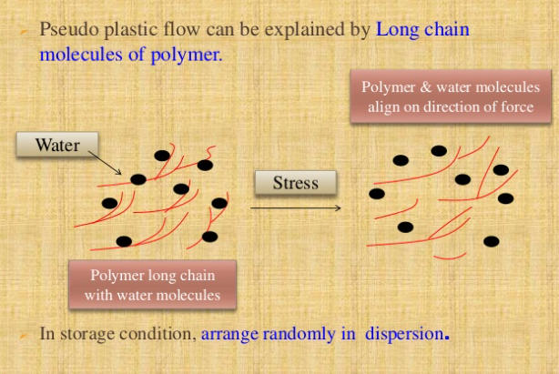
Pseudoplastic Flow (Cont..)

Slide 27
Pseudoplastic Flow (Cont..)
On applying F/A, shearing stress molecules ( water & polymer) arrange long axis in the direction of force applied.
This stress reduces internal resistance & solvent molecules released form polymer molecules.
Then reduce the concentration and size of molecules with decrease in viscosity

Slide 28
DILATANT FLOW
Certain suspensions with high % of dispersed solids shows an increase in resistance to flow with increasing rates of shear, such system increase in volume when sheared, such system called as dilatant flow.
Also, called as “ Shear thickening system” i.e. when stress is removed, dilatant system return to its original position

Slide 29
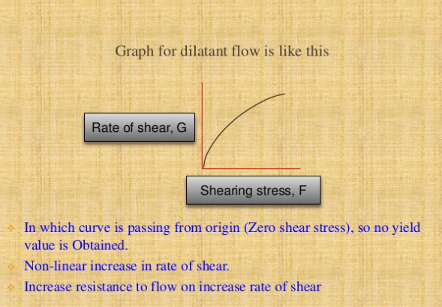
Dilatant Flow (CONT..)

Slide 30
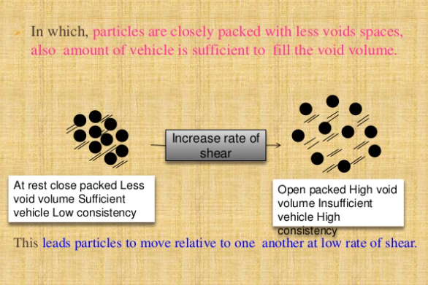
Dilatant Flow

Slide 31
Dilatant Flow (cont..)
So therefore, dilatant suspension can be poured from bottle because in these condition it is fluid.
When stress is increased, the particles shows the open packing and bulk of system (void volume is increase) is increased.
But the amount of vehicle is insufficient to fill this void space.
Thus particles are not wetted or lubricated and develop resistance to flow.
Finally system show the paste like consistency.

Slide 32
Dilatant flow Cont..
Behavior of this type suggests that appropriate precaution be used during processing of dilatant materials.
Conventionally, processing of dispersions containing solid particles is facilitated by the use of high-speed mixers, blenders, or mills.
Although this is advantageous with all other rheologic systems, dilatant materials may solidify under these conditions of high shear, thereby overloading and damaging processing equipment.

Slide 33
Lecture Content
Thixotropy
Rheogram of Thixotropy
Thixotropy in Formulation
Rheology in Pharmacy
Importance of Rheology in pharmacy
Applications

Slide 34
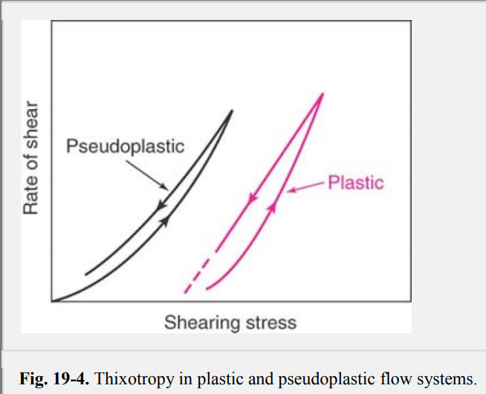
Thixotropy
As described in the previous sections, several types of behavior are observed when rate of shear is progressively increased and plotted against resulting shear stress.
It may have been assumed that if the rate of shear were reduced once the desired maximum had been reached, the down curve would be identical with, and superimposable on, the up curve.
Although this is true for Newtonian systems, the down curve for non-Newtonian systems can be displaced relative to the up curve. With shear-thinning systems (i.e., pseudoplastic), the down curve is frequently displaced to the left of the up curve, showing that the material has a lower consistency at any one rate of shear on the down curve than it had on the up curve.

Slide 35
Thixotropy cont..
This indicates a breakdown of structure (and hence shear thinning) that does not reform immediately when stress is removed or reduced.
This phenomenon, known as thixotropy, can be defined as ―an isothermal and comparatively slow recovery, on standing of a material, of a consistency lost through shearing.
As so defined, thixotropy can be applied only to shear-thinning systems. Typical rheograms for plastic and pseudoplastic systems exhibiting this behavior are shown in Figure 19-4.

Slide 36
Rheogram of Thixotropy

Slide 37
Thixotropy Cont..
Thixotropic systems usually contain asymmetric particles that, through numerous points of contact, set up a loose three dimensional network throughout the sample.
At rest, this structure confers some degree of rigidity on the system, and it resembles a gel. As shear is applied and flow starts, this structure begins to break down as points of contact are disrupted and particles become aligned.
The material undergoes a gel-to-sol transformation and exhibits shear thinning.
On removal of stress, the structure starts to reform. This process is not instantaneous; rather, it is a progressive restoration of consistency as asymmetric particles come into contact with one another by undergoing random Brownian movement.
Rheograms obtained with thixotropic materials are therefore highly dependent on the rate at which shear is increased or decreased and the length of time a sample is subjected to any one rate of shear.

Slide 38
Thixotropy Cont..
The Rheogram of thixotropic material depends on:
Rate at which shear increased or decreased.
Length of time during which sample is subjected to any one rate of shear.

Slide 39
Thixotropy in Formulation
Thixotropy is a desirable property in liquid pharmaceutical systems that ideally should have a high consistency in the container, yet pour or spread easily. For example, a well-formulated thixotropic suspension will not settle out readily in the container, will become fluid on shaking, and will remain long enough for a dose to be dispensed.
Finally, it will regain consistency rapidly enough so as to maintain the particles in a suspended state. A similar pattern of behavior is desirable with emulsions, lotions, creams, ointments, and parenteral suspensions to be used for intramuscular depot therapy.
With regard to suspension stability, there is a relationship between degree of thixotropy and rate of sedimentation; the greater the thixotropy, the lower the rate of settling. Concentrated parenteral suspensions containing from 40% to 70% w/v of procaine penicillin G in water were found to have a high inherent thixotropy and were shear thinning.
Consequently, breakdown of the structure occurred when the suspension was caused to pass through the hypodermic needle. Consistency was then recovered as rheologic structure reformed.
This led to formation of a depot of drug at the site of intramuscular injection where drug was slowly removed and made available to the body. The degree of thixotropy was related to the specific surface of the penicillin used.

Slide 40
Rheology in Pharmacy
Rheologic properties of a pharmaceutical system can influence the selection of processing equipment used in its manufacture.
Inappropriate equipment from this perspective may result in an undesirable product, at least in terms of its flow characteristics.
When classifying materials according to types of flow and deformation, it is customary to place them in one of two categories: Newtonian or non-Newtonian systems.
The choice depends on whether or not their flow properties are in accord with Newton's law of flow.

Slide 41
Importance of Rheology in pharmacy
Application in the formulation and analysis of such pharmaceutical products as emulsions, pastes, suppositories and tablet coatings.
Manufacturers of medicinal and cosmetic creams, pastes, and lotions must be capable of producing products with acceptable consistency and smoothness and reproducing these qualities each time a new batch is prepared.
In many industries, a trained person with extensive experience handles in-process material periodically during manufacture to determine its ―feel and ―body and judge proper consistency.

Slide 42
Applications
The viscosity of creams and lotions may affect the rate of absorption of the products by the skin.
A greater release of active ingredients is generally possible from the softer, less viscous bases.
The viscosity of semi-solid products may affect absorption of these topical products due to the effect of viscosity on the rate of diffusion of the active ingredients.
The rate of absorption of an ordinary suspension differs from thixotropic suspension.
Thixotropy is useful in the formulation of pharmaceutical suspensions and emulsions. They must be poured easily from containers (low viscosity).

Slide 43
References
Sinko PJ, Martin AN. Martin's physical pharmacy and pharmaceutical sciences: physical chemical and biopharmaceutical principles in the pharmaceutical sciences. 5 th Ed. Lippincott Williams & Wilkins; 2006.
Pharmaceutics: Basic Principles and Application to Pharmacy Practice edited by Alekha Dash, Somnath Singh, Justin Tolman

